Slide 1
Introduction to Final Accounts

Slide 2
ACCOUNTING
https://www.youtube.com/watch?v=5pce8qe-yMg
Recording
Analyzing
Summarizing
Financial transactions

Slide 3
Accounting Vs Book Keeping
Book Keepers: Records!!
Accountants: Interprets! Classifies!! Analyzes!!!
Managers: Decision Makers based on the Reports.

Slide 4

Objectives…
maintaining a complete and systematic record of all transactions
Accounting is highly significant to hospitality industry because it enables you to gain deep insights into the financial status of the business.

Slide 5
Final Accounts…
Final accounts refers to a company's ending account balances, which in turn are used to create financial statements, this means that the final accounts reveal the results of the business during a period, its financial position at the end of that period, and its sources and uses of funds during that period

Slide 6
Direct Expenses
Raw Material (Purchases)
Freight
Carriage Inward
Wages
Factory Rent
Fuel

Slide 7
Indirect Expenses
Salaries
Freight Outwards
Office Rent
Office Maintenance
Advertisements
Travelling Expenses
Printing and charges
Postage
Sales and Distribution expenses

Slide 8
The Three Parts of the Final Accounts
Trading
Profit and Loss
Balance Sheet

Slide 9
Why both the sides of a balance Sheet?
The Accounting Equation
A BUSINESS- LIABILITIES and ASSETS

Slide 10
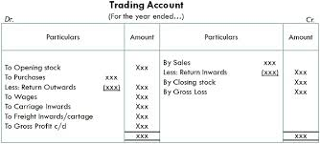
Format of a Trading Account

Slide 11
Difference between Return Inward and Return Outward
Sales Return
Purchase Return

Slide 12
Why to prepare Trading Account?
Trading account helps to know gross profit or loss
It helps to know the amount of purchases, expenses relating to purchases and manufacturing expenses
It helps to determine the selling price of the goods

Slide 13
Pick out only those expenses that will appear in the Trading Account
Freight Outward
Commission to Salesman
Electricity charges for Administration Office
Paid charges to office cleaner
Advertisement Expenses
Sample units distributed
Promotional Activities

Slide 14
Answer Now:
What are some of the salient features you have noticed in the Trading Account?

Slide 15
Prepare a Trading Account
Opening Stock- 10,000
Sales- 3,00,000
Purchases- 1,60,000
Wages – 30,000
Return Outward- 10,000
Return Inward- 16,000
Outstanding wages- 4,000
Carriage Inward- 10,000
Freight Inward- 8,000
Gas and Fuel- 8,000 (1,000 is prepaid)
Closing stock- 20,000

Slide 16
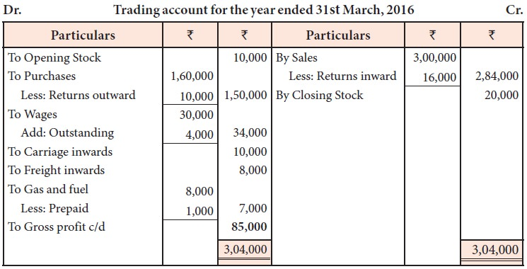
Solution

Slide 17
Solve these Questions:
Give three examples of each and explain them (a) Direct Expenses (b) Indirect Expenses
What are the objectives of accounting? What is a transaction?
Why do you think final accounts is prepared?

